Slide 1

Customer Behavior Analysis Dashboard
Power BI analysis of customer purchase patterns and revenue trends

Slide 2

PROJECT GOALS
Analysis Objectives
Purchase Patterns
Customer Segments
Analyze customer buying behavior and trends
Identify high-revenue customer groups
Product Performance
Business Insights
Understand revenue by product and demographics
Support data-driven decision-making

Slide 3
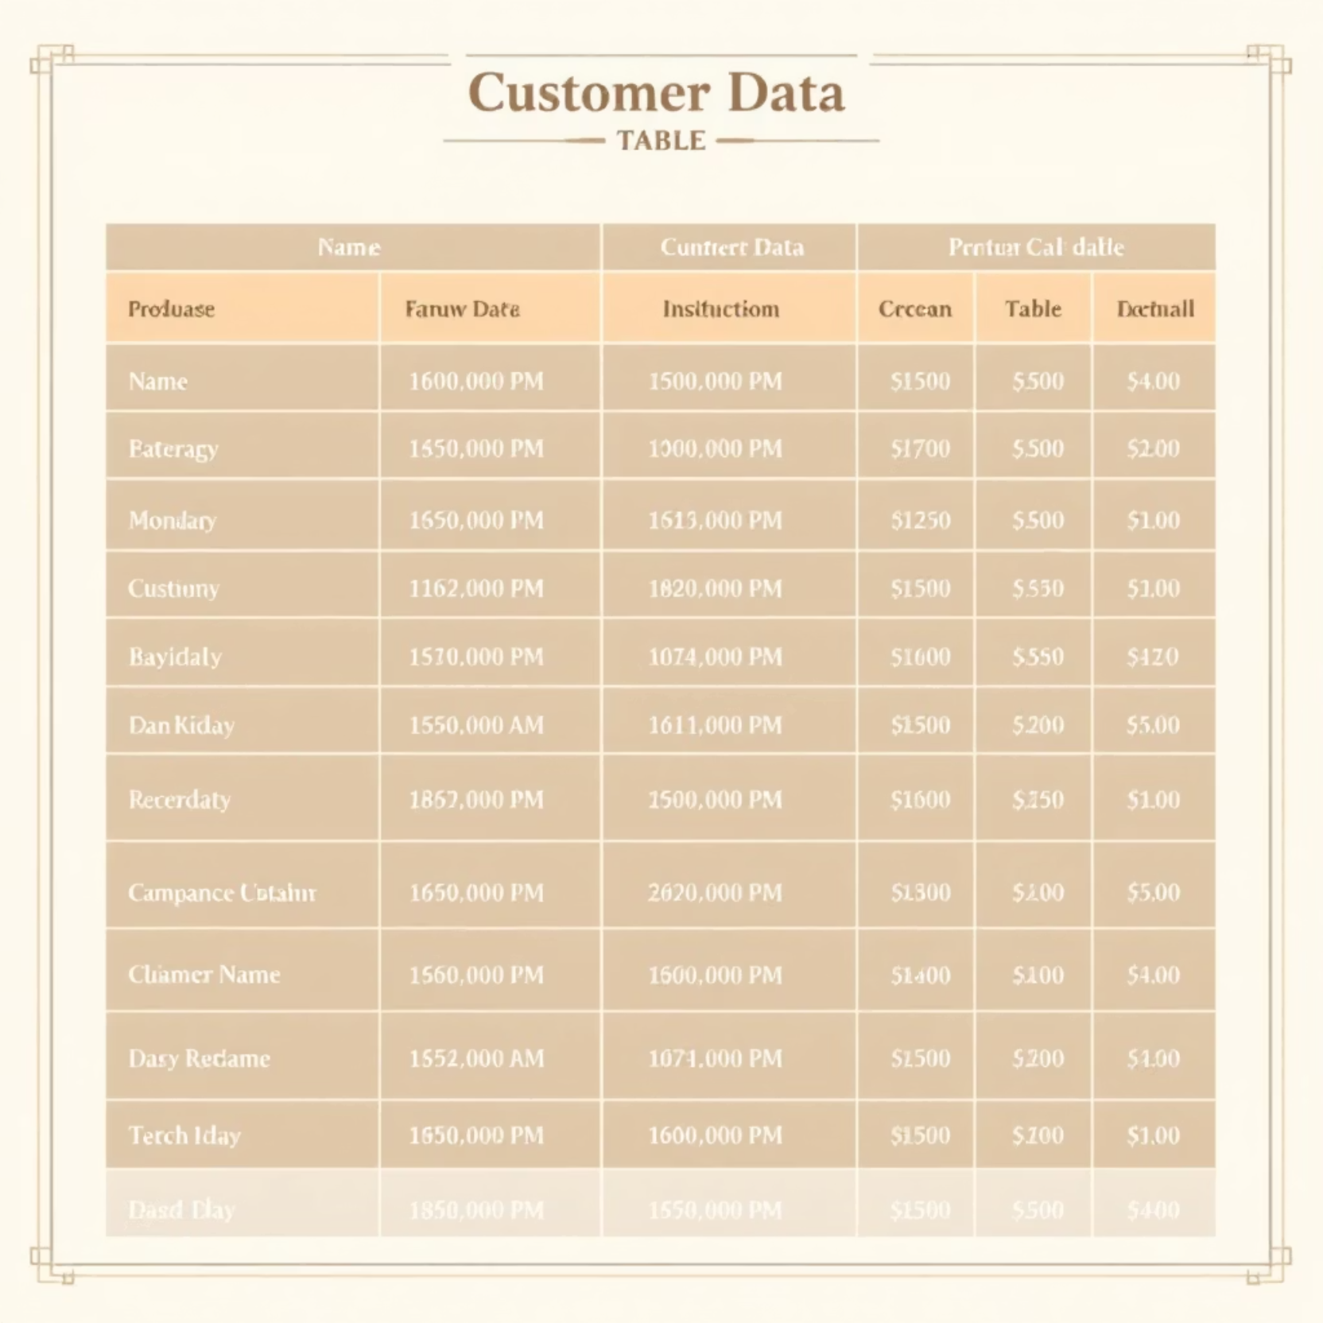
Dataset Overview
Data Components
Customer demographics (gender, age)
Purchase details (items, revenue)
Discount rates applied
Subscription status
Shipping preferences

Slide 4

PYTHON
Data Cleaning & Transformation
01
Data Loading
Imported dataset using Pandas library
02
Initial Exploration
Used df.info() and .describe() for structure analysis
03
Data Cleaning
Handled missing values and corrected data types
04
Standardization
Normalized categorical fields for consistency

Slide 5
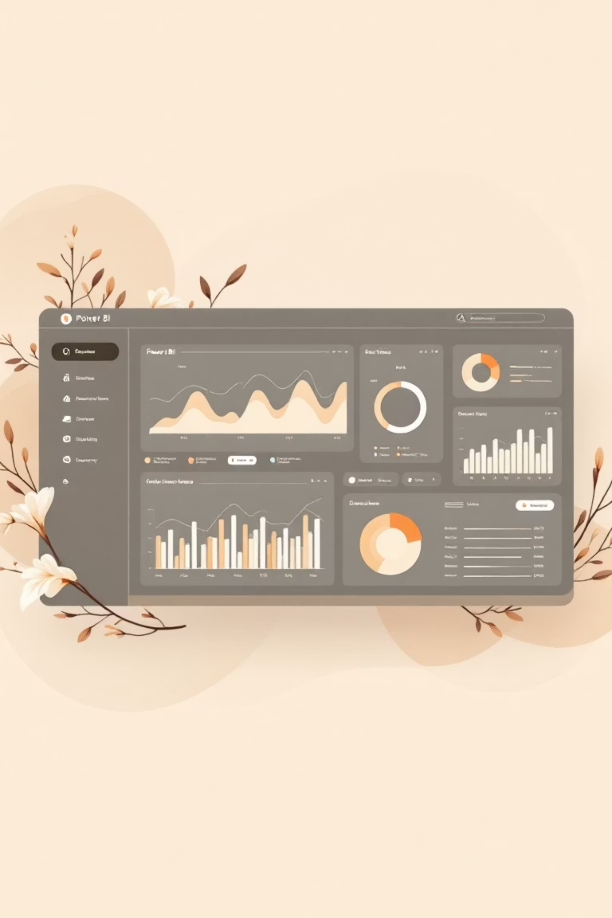
Interactive Dashboard Design
KPIs & Metrics
Visual Charts
Real-time performance indicators
Interactive graphs and tables
Dynamic Slicers
Filter data by multiple dimensions

Slide 6

KEY INSIGHT
Gender-wise Revenue Analysis
Male Customers
Contribute higher revenue share compared to female customers

Slide 7
Age Group Revenue Contribution
Seniors
Moderate contribution
Young Adults
Growing segment
Adults
Highest revenue generators
Middle-Aged
Strong purchasing power

Slide 8

Top-Performing Products
1
2
3
Sneakers
Coats
Sweaters
Leading revenue driver
High-value purchases
Consistent performer
4
Pants
Strong sales volume

Slide 9

CRITICAL FINDING
Subscription Impact
Subscribed customers contribute significantly more revenue compared to non-subscribed customers
Subscription plans drive higher customer lifetime value and repeat purchases

Slide 10




Business Recommendations
Promote Subscriptions
Increase customer lifetime value through subscription plans
Target High-Revenue Segments
Personalized marketing for adults and middle-aged customers
Optimize Inventory
Focus on high-performing products like sneakers and coats
Enhance Shipping Strategy
Align shipping options with customer preferences
Conclusion: This Power BI analysis provides actionable insights for data-driven business decisions and revenue optimization

